Slide 1
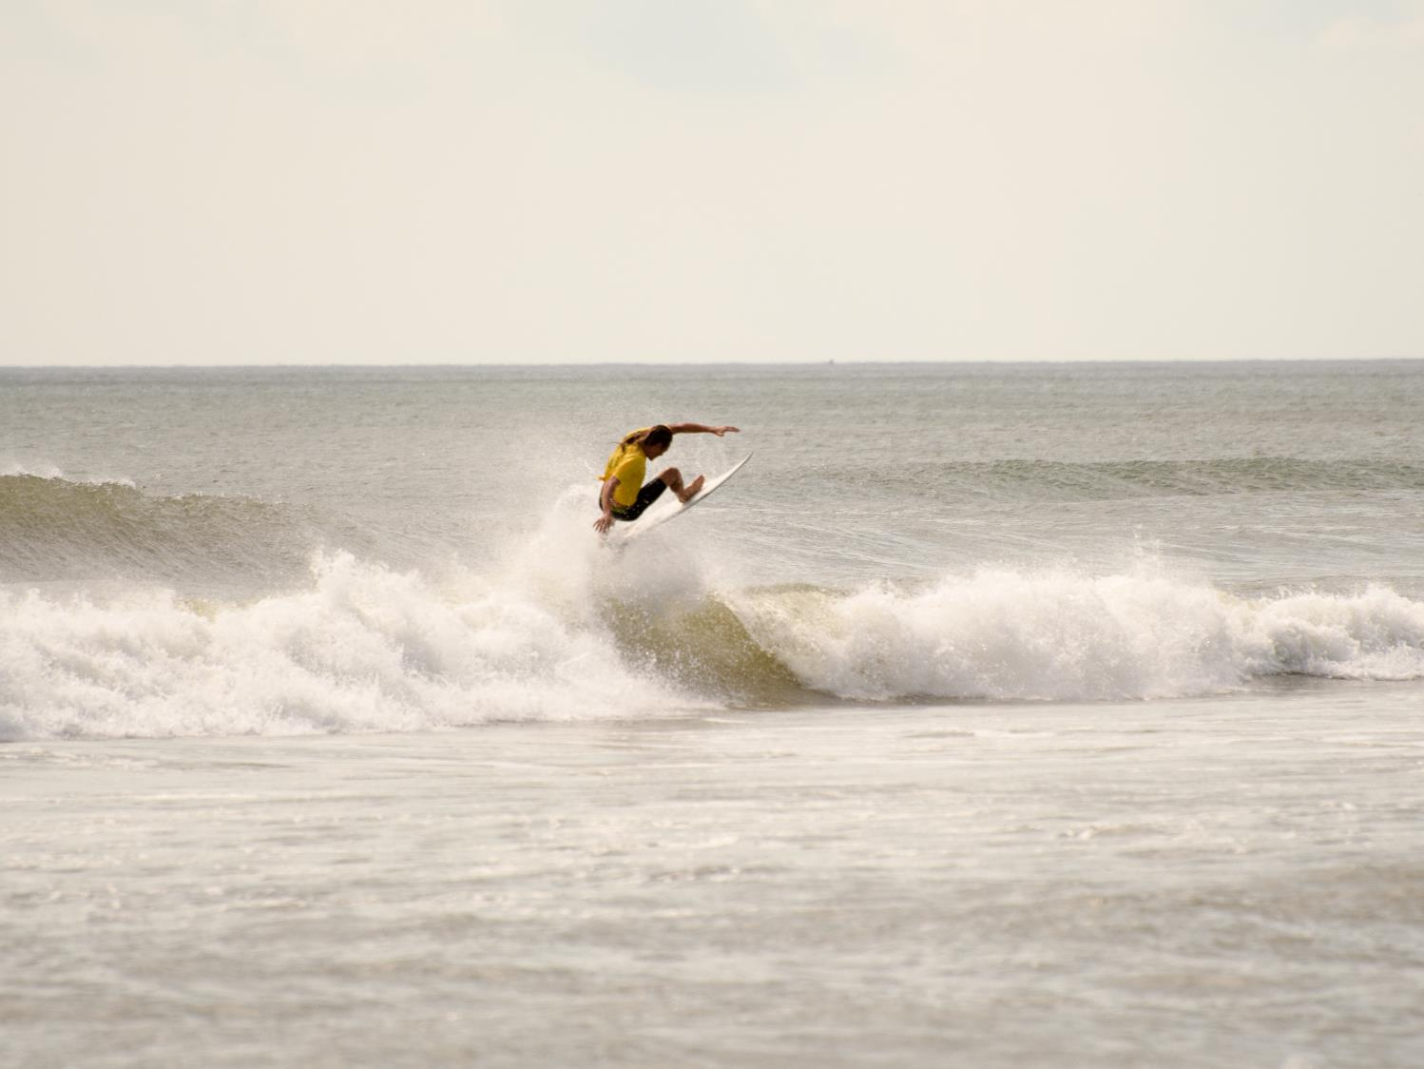
Mid-Atlantic Non-Consumptive Recreation Workshop
Brock Environmental Center
Virginia Beach, VA November 8, 2017

Slide 2
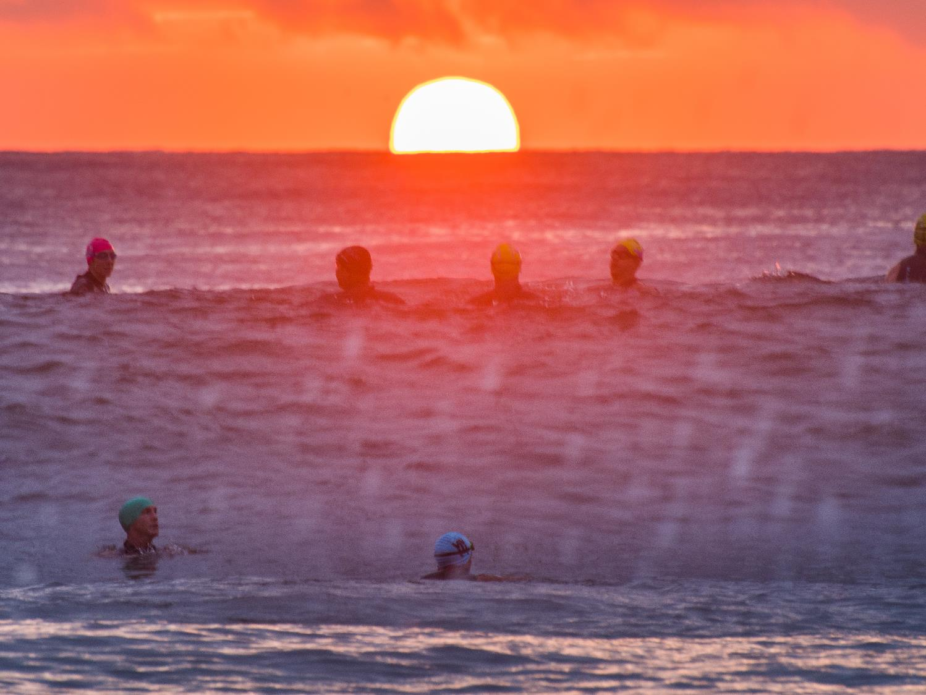
Thank you to our hosts: Laura McKay
Virginia Coastal Zone Management Program
Brock Environmental Center Mid Atlantic Regional Council on the Ocean Surfrider Foundation

Slide 3
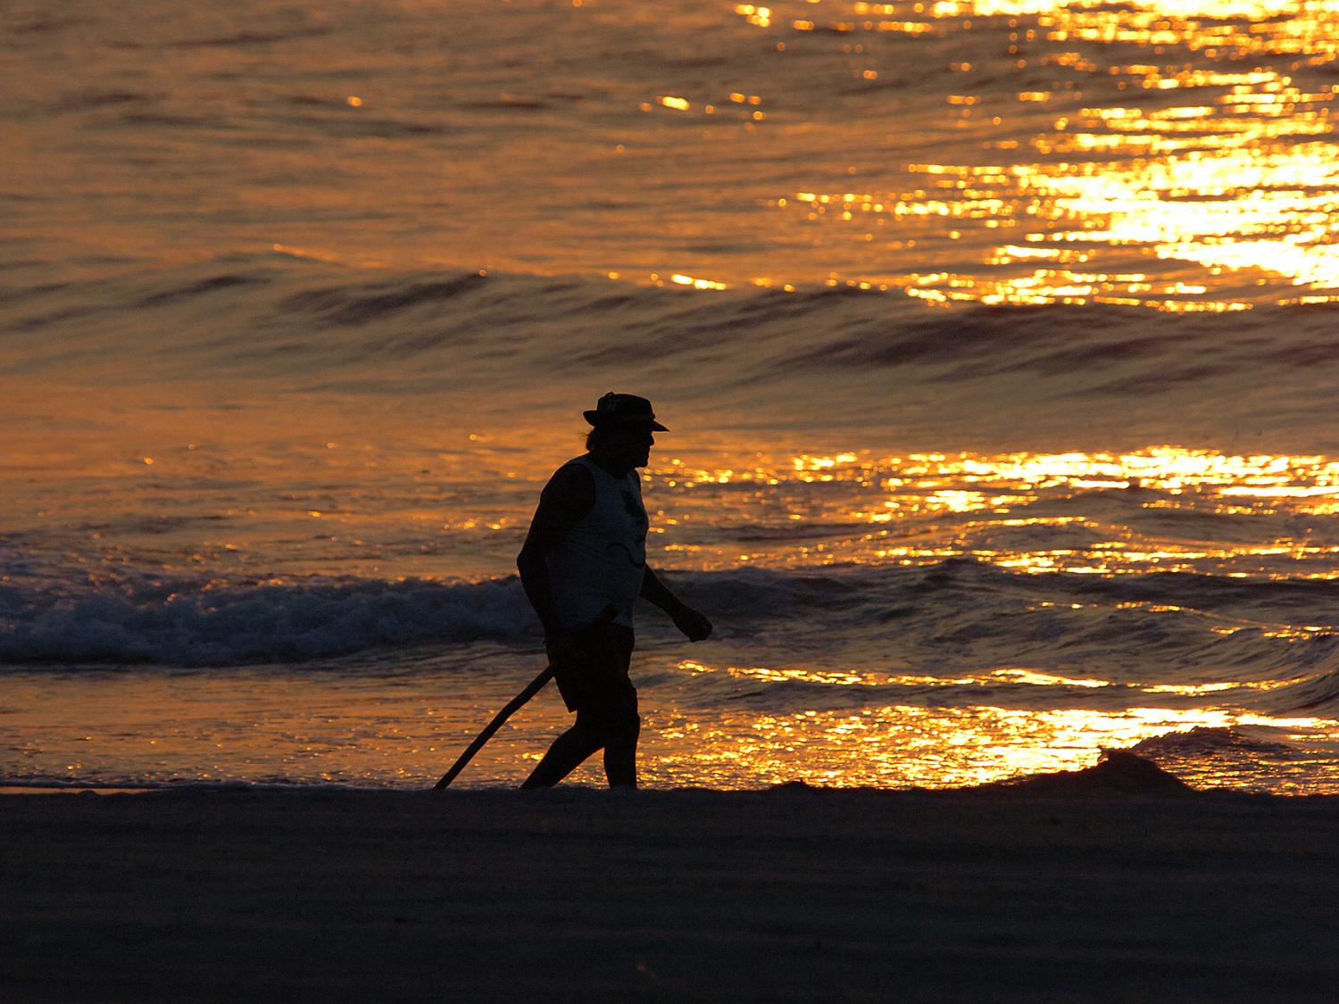
Overview of the Mid-Atlantic Regional Planning Body
ESTABLISHED in April 2013 to design and implement collaborative Mid-Atlantic regional ocean planning
PRIMARY PURPOSE is to improve coordination, share data, and build collaborative relationships to address regional ocean issues.

Slide 4
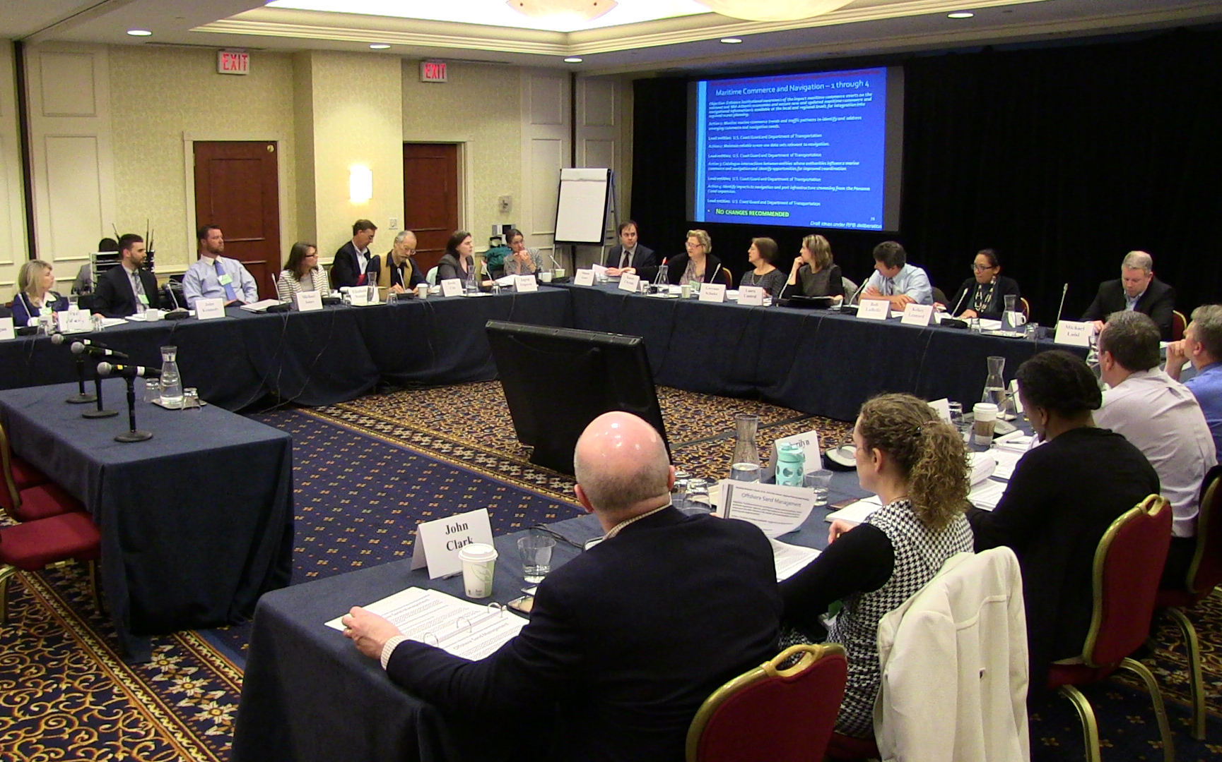
Includes representatives of:
6 Mid-Atlantic states: NY, NJ, PA, DE, MD, and VA
2 federally-recognized Tribes in the region: the Shinnecock Indian Nation and the Pamunkey Indian Tribe
Mid-Atlantic Fishery Management Council
8 Federal agencies with ocean interests
Connecticut serves as an ex-officio member
Website: www.boem.gov/Mid-Atlantic-Regional-Planning-Body
Email address: MidAtlanticRPB@boem.gov

Slide 5
Public input: a priority throughout Draft Plan development
5 in-person public RPB meetings with public comment sessions
4 public webinars to present and hear input about draft RPB products
3 public workshops to discuss input about draft RPB products
10 public listening sessions in Mid-Atlantic States
2 Tribal listening sessions in VA and NY
Numerous additional sector-specific and data-focused outreach efforts
Summer of 2016:
Release of Draft Mid-Atlantic Regional Ocean Action Plan for 60 days of public comment on July 6
Convening of 5 open house public listening sessions in the Mid-Atlantic States to share information about Draft Plan and receive public input

Slide 6
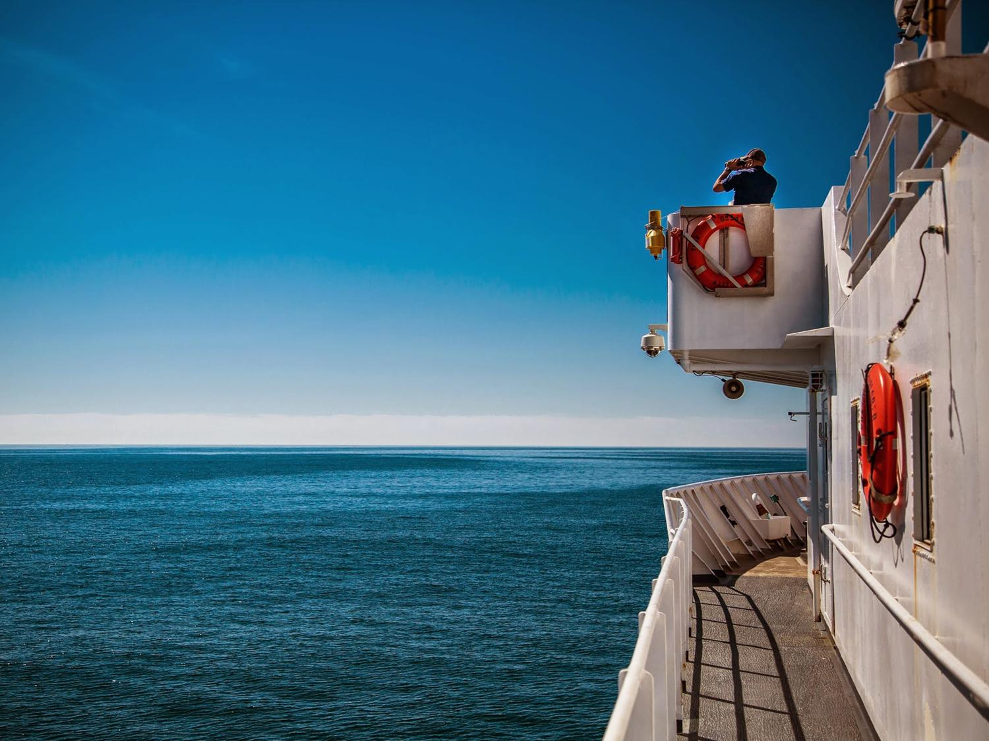
Mid-Atlantic regional ocean planning strives for better coordination and collaboration between governmental agencies with existing management authority over our region’s ocean and coastal resources.
The Mid-Atlantic Regional Ocean Action Plan focuses on informing how we implement existing authorities, but the RPB itself DOES NOT have any regulatory authority.
Plan was certified by the National Ocean Council in December 2016.

Slide 7
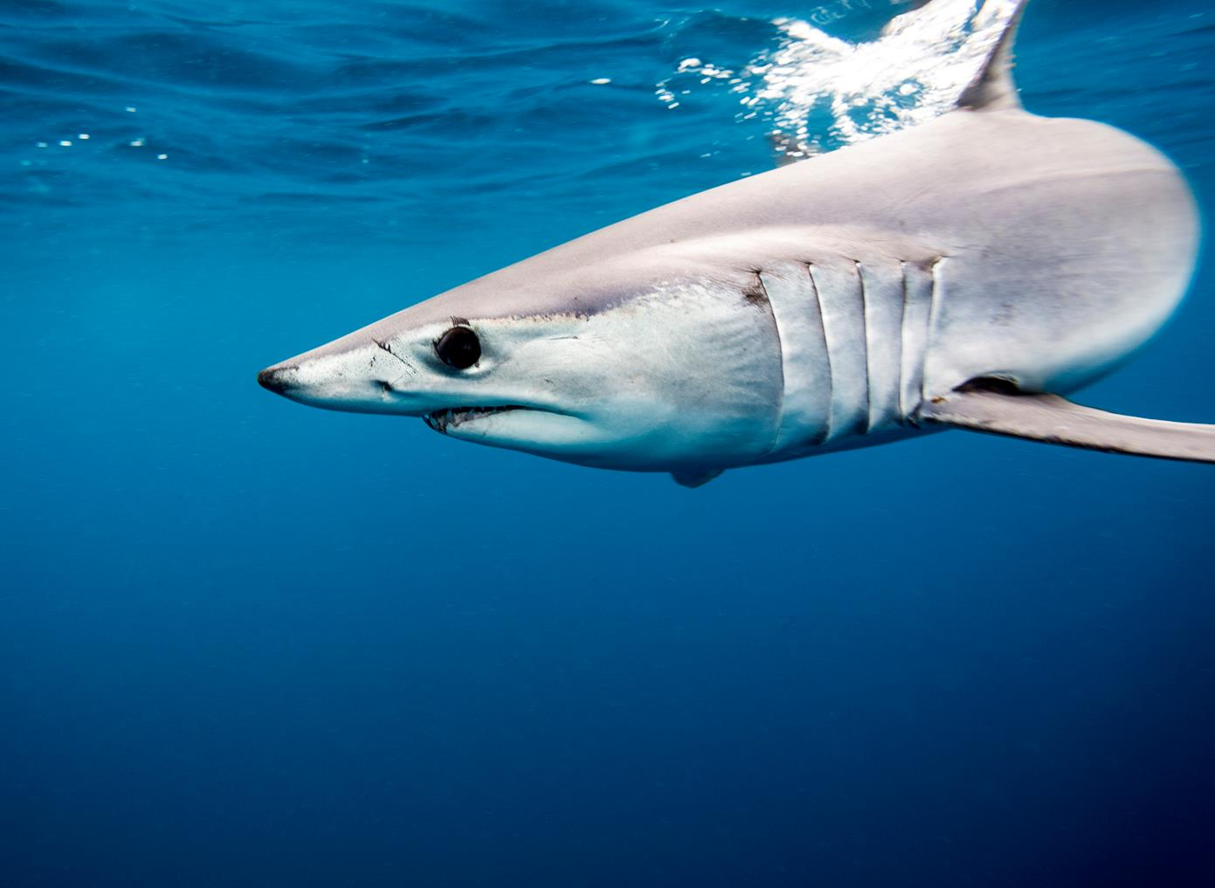
Actions to Promote a Healthy Ocean Ecosystem
OBJECTIVE 1 – Discover, understand, protect, and restore the ocean ecosystem
OBJECTIVE 2 – Account for ocean ecosystem changes and increased risks
OBJECTIVE 3 – Value Traditional Knowledge
ACTION 1 Identify ecologically rich areas of the Mid-Atlantic and increase understanding of those areas to foster more informed decision making.
ACTION 2 Map shifts in ocean species and habitats.
ACTION 3 Develop a Mid-Atlantic Ocean Acidification Monitoring Network.
ACTION 4 Develop a regionally appropriate strategy for marine debris reduction.
ACTION 5 Develop indicators of the health of the Mid-Atlantic regional ocean ecosystem.
ACTION 6 Incorporate Traditional Knowledge of Tribes regarding ocean health in regional ocean planning in the Mid-Atlantic.

Slide 8
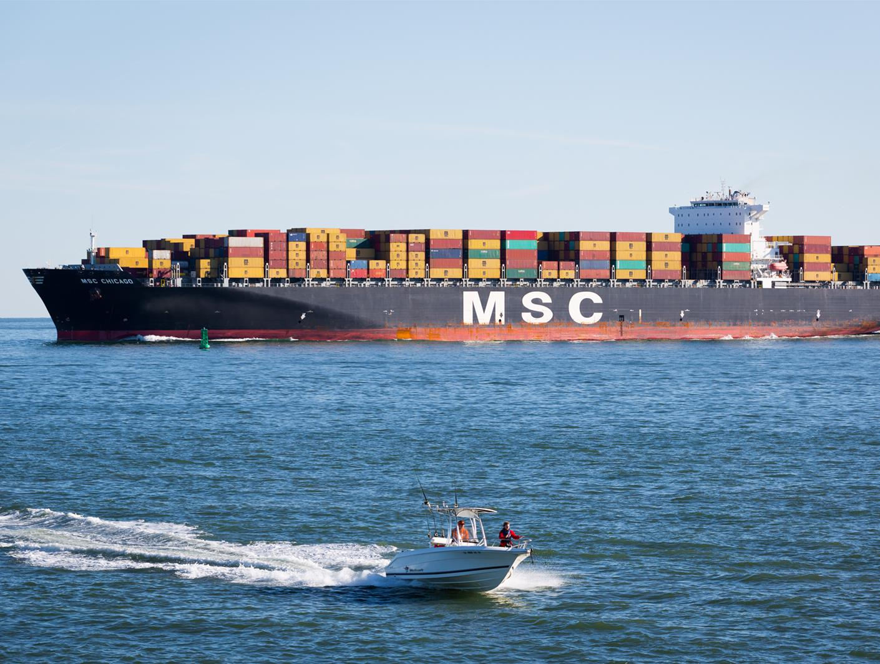
Actions to Promote Sustainable Ocean Uses
33 actions address 9 objectives related to these ocean uses:
National security
Ocean energy
Commercial and recreational fishing
Ocean aquaculture
Maritime commerce and navigation
Sand management
Non-consumptive recreation
Tribal interests and uses
Critical undersea infrastructure

Slide 9
Non-Consumptive Recreation
OBJECTIVE 7: Account for the importance of nearshore and offshore non-consumptive recreational uses, and their local and regional economic contributions in the Mid-Atlantic; and in the management of other ocean uses and resources, consider impacts on non-consumptive recreational activities (e.g., surfing, boating, whale watching, birding, diving).
ACTION 1 Identify, characterize, and share information about measures to maintain the recreational value of important non-consumptive recreational areas and the activities they sustain.

Slide 10
Non-Consumptive Recreation Action Steps
A. Define, in collaboration with stakeholders, what it would mean for ocean and coastal uses and areas to be considered important for nonconsumptive recreation. A variety of factors may be considered (e.g., intensity of use, contributions to local economies, maintaining dark skies and natural sounds). Complete identification and mapping of such areas and put them on the Data Portal. (short-term and ongoing)
B. Identify and assess potential impacts and use conflicts to important non-consumptive recreational uses from other human uses, as well as potential impacts and conflicts between non-consumptive recreational uses and marine and coastal resources. (short-term and ongoing)
F. Convene stakeholders, the public, and RPB entities throughout the region to review findings and improve communication to increase understanding of recreational uses with and between agencies, stakeholders, and the public. (short-term and ongoing)

Slide 11
Non-Consumptive Recreation Action Steps
C. Work with USFWS to develop and disseminate guidance for recreational users on best practices that reduce potential impacts between recreational activities and marine and coastal wildlife. (short-term and ongoing)
D. Identify, catalogue, and highlight potential improvements to current Federal, State, and Tribal authorities, standards, and processes for maintaining non-consumptive recreational uses. (short-term)
E. Develop and publicly post report(s) for Federal agencies, States, Tribes, and the RPB on potential improvements to practices and processes as determined necessary, feasible, and appropriate. (short-term and ongoing)

Slide 12
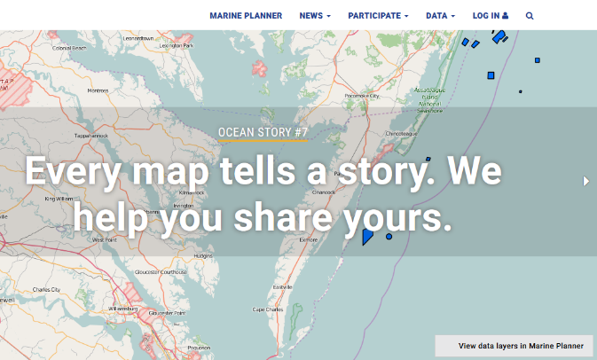
Recreation Information on the Data Portal
The Mid-Atlantic Ocean Data Portal (Data Portal) is:
A key resource informing ocean planning
A central, publicly accessible location for interactive ocean mapping and information
A tool for Federal, State, Tribal, and local decision makers, as well as the general public to visualize and analyze ocean resources and human use information
It can be accessed here: http://portal.midatlanticocean.org
Past workshops with participatory GIS and online surveys have populated the Portal with data and information about recreational uses

Slide 13
Tonight’s Workshop Objectives
To enhance long-term relationships with recreational users by creating an opportunity for engagement with decision makers to increase understanding of recreational uses;
To begin to define what it would mean for ocean and coastal uses and areas to be considered important for non-consumptive recreation;
To solicit ideas for a process to identify and assess potential impacts and use conflicts to important non-consumptive recreational uses from other human uses, as well as potential impacts and conflicts between non-consumptive recreational uses and marine and coastal resources; and
To explore ideas for effective two-way engagement processes to share information with and solicit input from ocean recreation users.
Notes:
Recognize a lot to cover; will work with the group to see if there is a particular area you would like to spend more time on and adjust accordingly

Slide 14
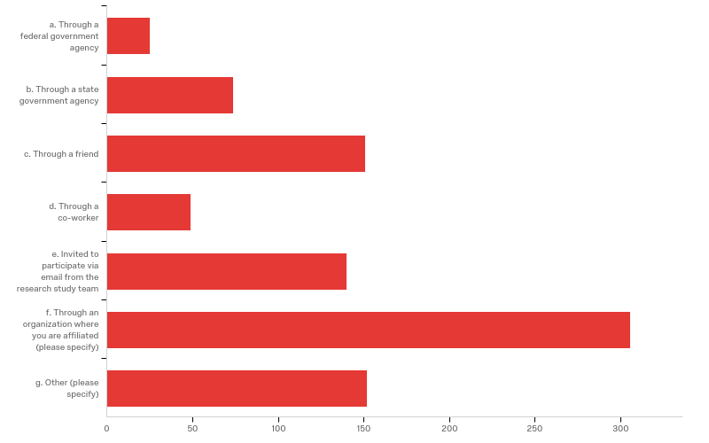
Mid-Atlantic Non-consumptive
Recreational Use Survey
Survey was available for public response from July 5, 2017 through to September 5, 2017.
A total of 1,000 responses were received (962 full, 38 partial)
(Responses received- Virginia- 120)
How did you hear about this study? (Check all that apply)
# | Answer | % | Count
1 | Through a federal government agency | 2.79% | 25
2 | Through a state government agency | 8.25% | 74
3 | Through a friend | 16.83% | 151
4 | Through a co-worker | 5.46% | 49
5 | Invited to participate via email from the research study team | 15.61% | 140
6 | Through an organization where you are affiliated (please specify) | 34.11% | 306
7 | Other (please specify) | 16.95% | 152
 | Total | 100% | 897
Surfrider was the number one organization for
respondents who selected “Through an
Organization” or “Other” (149 respondents)

Slide 15
Mid-Atlantic Non-consumptive
Recreational Use Survey
Non-consumptive recreation is any non-hunting or non-extractive (i.e. not removing anything from its natural environment) recreational use that provides an experience rather than a product. Please identify up to 3.
# | Answer | % | Count
1 | Shore use | 21.88% | 530
2 | Scenic/natural views | 16.76% | 406
3 | Paddling | 16.06% | 389
4 | Swimming | 16.06% | 389
5 | Surface water sports | 8.05% | 195
6 | Charter wildlife viewing | 5.37% | 130
7 | Motorized boating | 4.25% | 103
8 | Sailing | 3.59% | 87
9 | Historic/cultural | 3.43% | 83
10 | Scuba | 2.60% | 63
11 | Charter scenic viewing | 0.99% | 24
12 | Charter diving/snorkeling | 0.66% | 16
13 | Charter transport | 0.21% | 5
14 | Charter party cruises | 0.08% | 2
 | Total | 100% | 2,422

Slide 16
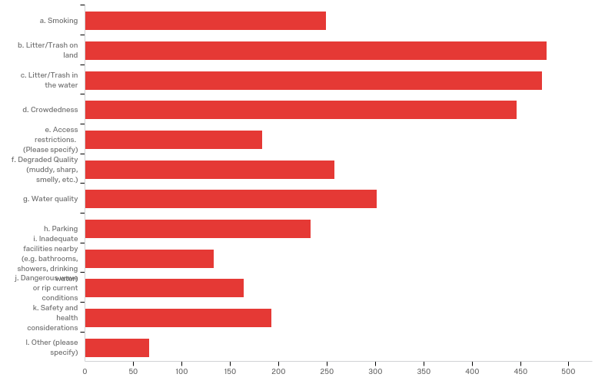
Mid-Atlantic Non-consumptive
Recreational Use Survey
When you have participated in non-consumptive recreational activities, what negative issues have interfered
with your enjoyment?

Slide 17
Mid-Atlantic Non-consumptive
Recreational Use Survey
When you have participated in non-consumptive recreational activities, what negative issues have interfered
with your enjoyment?
# | Answer | % | Count
1 | Litter/Trash on land | 15.01% | 477
2 | Litter/Trash in the water | 14.89% | 473
3 | Crowdedness | 14.04% | 446
4 | Water Quality | 9.51% | 302
5 | Degraded Quality (muddy, sharp, smelly) | 8.12% | 258
6 | Smoking | 7.84% | 249
7 | Parking | 7.33% | 233
8 | Safety and health considerations | 6.07% | 193
9 | Access restrictions | 5.76% | 183
10 | Dangerous wave or rip current conditions | 5.16% | 164
11 | Inadequate facilities nearby | 4.19% | 133
12 | Other | 2.08% | 66
 | Total | 100% | 3,177

Slide 18
Mid-Atlantic Non-consumptive
Recreational Use Survey
When you have participated in non-consumptive recreational activities, what negative issues have interfered
with your enjoyment?
# | Answer = Other | Count
1 | ATV use or illegal personal watercraft usage | 13
2 | Drunks on the beach/Disrespect of resources | 10
3 | Dogs (and everything that comes along with them) | 8
4 | Other boaters not following rules | 6
5 | Lack of Public Access/Lack of Transportation | 5
6 | Parking fees/Bathroom conditions/Beach Fees | 4
7 | Loud music/cell phone use | 3
8 | Removal or degradation of plant life for active recreation/crowds | 3
9 | Coastal erosion/Algae blooms/oil on beach | 3
10 | Bugs/Insects/Mosquitos | 3
11 | Jellyfish/sharks | 3
12 | Fishing in posted swimming areas | 2
13 | Weather (e.g. rain or high winds) | 2
14 | Destruction of surfing breaks by beach replenishment | 1
15 | Lack of free water filling stations for water containers | 1

Slide 19
Discussion Session
Topics will include:
Defining important areas
Identifying potential impacts and use conflicts
3. Developing effective engagement

Slide 20
Defining important areas
What factors should be considered when defining an area as important for non-consumptive recreation? (examples from OAP include: intensity of use, contributions to local economies, maintaining dark skies and natural sounds).
How can these factors be prioritized?
Does the MARCO Ocean Data Portal cover these factors adequately? If not, where could we get that information?

Slide 21
Identifying potential impacts and use conflicts
How can we further identify and assess potential impacts and use conflicts to important non-consumptive recreational uses from other human uses (also other recreational uses)?
How can we further identify potential impacts and conflicts between non-consumptive recreational uses and marine and coastal resources?
How can these impacts and conflicts be prioritized?

Slide 22
Developing effective engagement
What do you see as the current barriers to effective two-way engagement processes where state and federal agencies are sharing information with and soliciting input from ocean recreation users?
What is working/not working now?
How can we improve engagement?
Do other models exist?

Slide 23
For more information
Laura McKay
Virginia Coastal Zone Management Program
laura.mckay@deq.virginia.gov
Members of the public and stakeholders are encouraged to provide comments to the Mid-A RPB at any time via email MidAtlanticRPB@boem.gov

