Slide 1
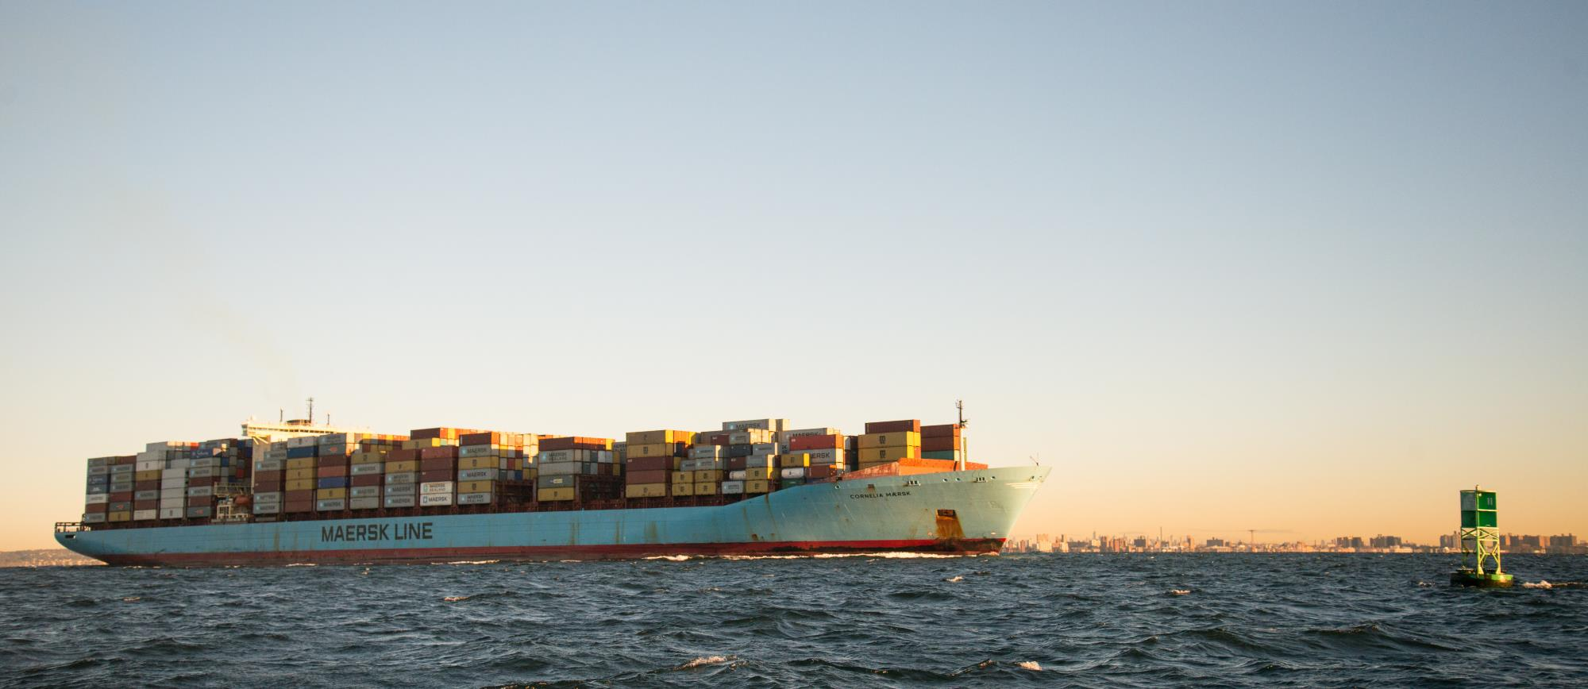
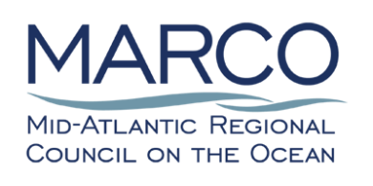
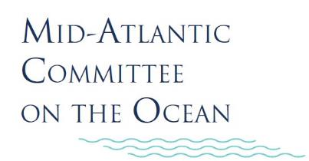
MACO Webinar: Mid-Atlantic Port Access & Navigation Safety Studies
OCTOBER 8 | 2 to 3:30 P.M.

Slide 2
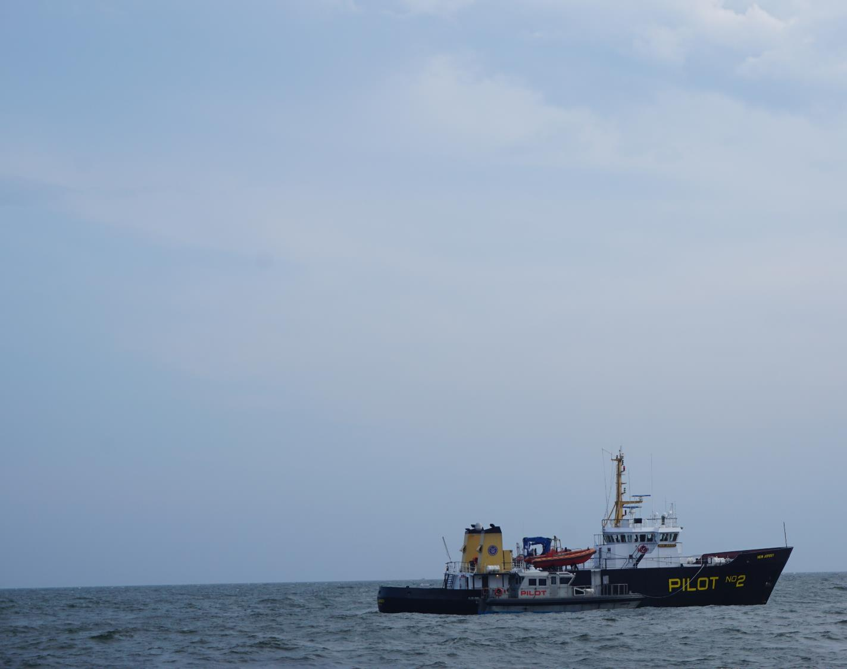
Welcome to the Webinar
Kevin Hassell, Chair,
Mid-Atlantic Committee on the Ocean
Audience audio/cameras are disabled by default.
Questions may be submitted at any time in the Questions box. They will be read aloud and answered during Q&A session following the presentations and panel.
Speaker emails will be shared at end of webinar.
Webinar recording and slides will be posted at midatlanticocean.org

Slide 3
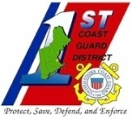
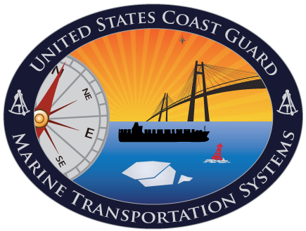
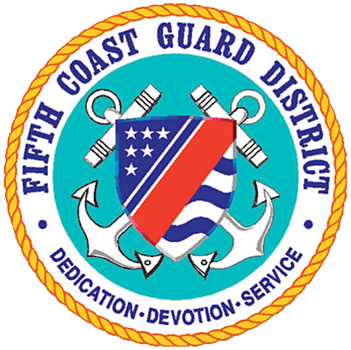
United States Coast Guard
MID-ATLANTIC PORT ACCESS AND NAVIGATION SAFETY STUDIES PRESENTATION
FOR THE
MID-ATLANTIC COMMITTEE ON THE OCEAN (MACO)
Mr. George Detweiler, Coast Guard Headquarters, Washington, DC
Ms. Michele DesAutels, First Coast Guard District, Boston, MA
CAPT Maureen Kallgren, Fifth Coast Guard District, Portsmouth, VA

Slide 4
COAST GUARD ROLES, RESPONSIBILITIES & OBJECTIVES
Promote and maintain a safe, secure, efficient environmentally sound, and resilient Marine Transportation System (MTS)
Ensure safe and efficient navigation routes to and from US major ports
Ensure a safe, secure and resilient flow of national defense and commercial vessels - vital to both our Nation’s national and economic security
Balance competing interests offshore, e.g., MTS, wind farms and other renewable energy areas, fishing, recreation, tourism, aquaculture, etc.
Protection of
All mariners
Property (wind farm(s) or other structures/equipment)
Environment

Slide 5
PORT ACCESS ROUTE STUDY (PARS)
Coast Guard is required (by law) to conduct a PARS before establishing new or adjusting existing Traffic Separation Schemes (TSSs) or fairways.
Consult / coordinate with Federal, State, and foreign state agencies (as appropriate) and maritime community representatives, environmental groups, and other interested stakeholders.
Primary purpose of this coordination is, to the extent practicable, to reconcile the need for safe access routes with other reasonable waterway uses.
PARS (complete or modified) may be used to determine and justify if safety zones, security zones, recommended routes, regulated navigation areas and other routing measures should be created

Slide 6
PARS EXAMPLES
Atlantic Coast PARS (ACPARS)
Bering Strait PARS
Nantucket Sound PARS
Massachusetts – Rhode Island PARS (MARIPARS)
North Atlantic Right Whale PARS
Strait of Juan De Fuca PARS

Slide 7
ATLANTIC COAST PORT ACCESS ROUTE STUDY
Study conducted study between 2011 – 2017
Identified navigation safety corridors along the Atlantic Coast
Corridors included deep draft routes and coastal tug and barge routes
Report recommended developing these navigation safety corridors into shipping safety fairways (fairways)

Slide 8
SHIPPING SAFETY FAIRWAYS
Must be created via the Federal Rulemaking Process
1st Step was to publish an Advance Notice of Proposed Rulemaking (ANPRM) on June 19, 2020,
Docket # USCG – 2019 – 0279
ANPRM also reminded readers that USCG had announced potential studies of port approaches and international entry and departure areas published in the Federal Register on March 15, 2019 (84 FR 9541)
Solicited comments about the establishment of fairways via a suite of questions in the notice
Provided a comment period ending August 18, 2020
ANPRM identified the fairways by name and geographical position
Review comments as preparation for developing a Notice of Proposed Rulemaking (NPRM)
Publish a Notice of Proposed Rulemaking (NPRM)

Slide 9
FAIRWAYS AND SUPPLEMENTAL PARS AREAS OF STUDY

Slide 10
SUPPLEMENTAL PARS RECOMMENDATIONS
Supplemental PARS could recommend:
Status Quo (no changes)
Fairways: A lane or corridor in which no artificial island or structure, whether temporary or permanent, will be permitted so that vessels using U.S. ports will have unobstructed approaches.
Act like a routing measure – vessels operate as such
Fairways only created domestically – require regulations in 33 CFR 166
Created by USCG
Limited Access Areas (safety and security zones, restricted navigation areas (RNAs))
Created domestically – require regulations
Anchorages – require regulations

Slide 11
SUPPLEMENTAL PARS RECOMMENDATIONS
Routing measures:
Created by the USCG
Approved internationally by the International Maritime Organization (IMO)
Approved domestically
Recommendatory, not mandatory
Some examples are:
Area to be avoided (ATBA)
No Anchoring Area
Precautionary area
Traffic Separation Scheme (TSS)
Traffic lane
Separation Zone or separation line

Slide 12
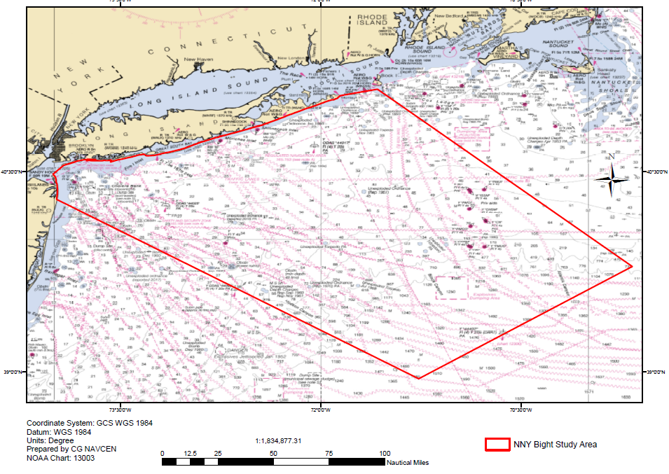
FIRST DISTRICT – NORTHERN NEW YORK BIGHT PARS
The Notice of Study was published on June 29, 2020. It is available at Federal Register docket number USCG-2020-0278, on the federal portal at https://www.regulations.gov/docket?D=USCG-2020-0278.
The Coast Guard hosted two virtual public meetings:
Thursday, July 30th, 9 a.m. EST
Tuesday, August 11th, 6 p.m. EST
The comment period closed August 28, 2020.
21 Comments received from Government, Fishing, Offshore Wind, Maritime Transportation System users
Recommendations include consideration of additional data, studies, and stakeholder outreach in addition to specific routing measures.
Next steps include in-depth comment analysis, coordination with HQ/D5 and potential stakeholder outreach.
Publication of PARS final results will be in the Federal Register and may take 12 months or more to complete from Notice of Study (June 2020).

Slide 13
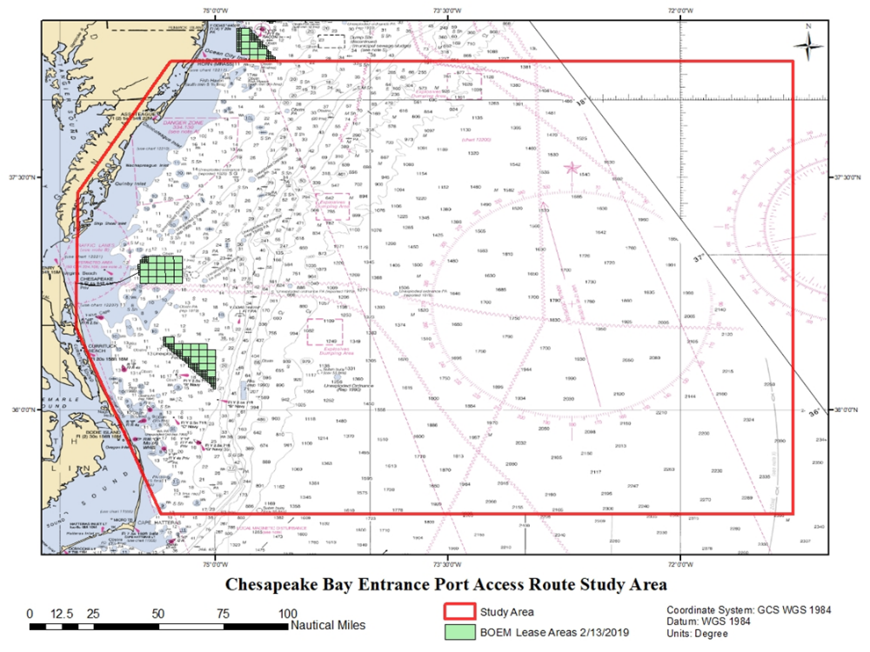
FIFTH DISTRICT – APPROACHES TO THE CHESAPEAKE BAY
Published Notice on November 27, 2019, Docket number USCG-2019-0862
Comment period closed January 27, 2020
09 comments received from the public
Traffic Analysis completed and AIS data reviewed/compiled
Possible routing measures under consideration but not yet confirmed
Consultations underway with interested parties
Draft report estimated November 2020

Slide 14
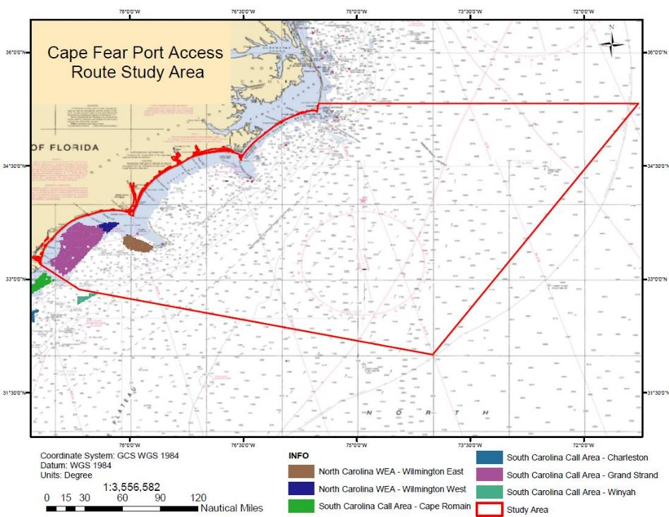
FIFTH DISTRICT – NC SEACOAST AND CAPE FEAR RIVER APPROACHES
Published Notice on March 23, 2020, Docket number USCG-2020-0093
Comment period closed May 23, 2020
04 comments received from the public
Draft report estimated June 2021

Slide 15
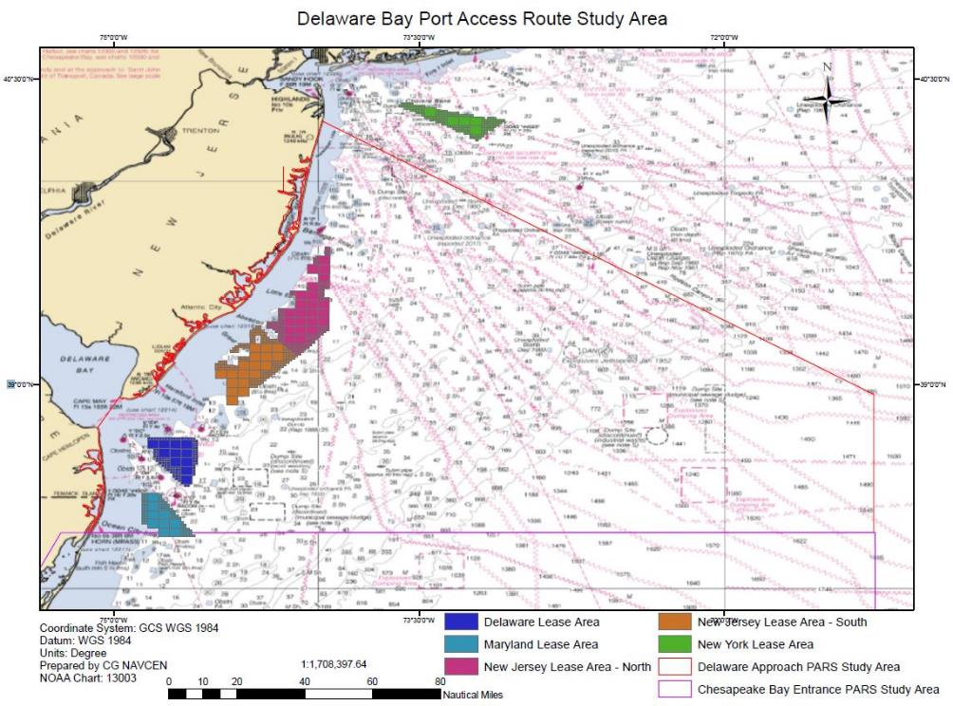
FIFTH DISTRICT – NJ SEACOAST AND DELAWARE BAY APPROACHES
Published Notice on May 5, 2020, Docket number USCG-2020-0172
Initial comment period closed July 6, 2020
18 comments received from the public
Public meetings scheduled Oct 29 and Nov 4 via virtual platform
Comment period re-opened until Nov 10, 2020
Draft report estimated March 2021

Slide 16
QUESTIONS
Headquarters
George Detweiler
George.H.Detweiler@uscg.mil
202-372-1566
First District
Michele DesAutels
Michele.E.DesAutels@uscg.mil
617-223-8068
Fifth District
CAPT Maureen Kallgren
Maureen.R.Kallgren@uscg.mil
757-398-6250

Slide 17
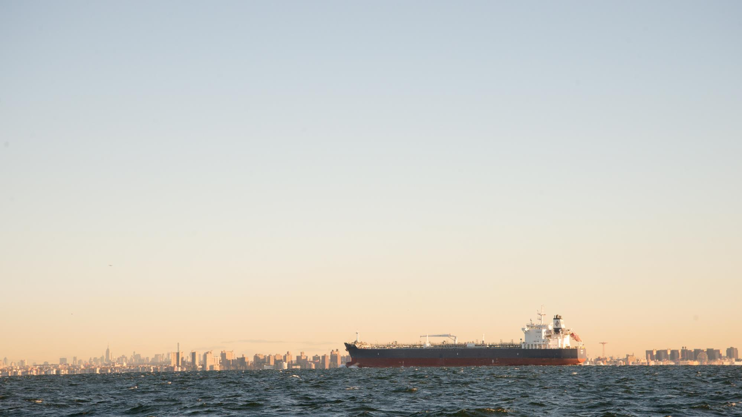
Thanks to Today’s Speakers
Coast Guard
George Detweiler George.H.Detweiler@uscg.mil
Michele DesAutels Michele.E.DesAutels@uscg.mil
Capt. Maureen Kallgren Maureen.R.Kallgren@uscg.mil
Mid-Atlantic Ocean Data Portal
Nick Napoli/Karl Vilacoba portal@midatlanticocean.org
Panelists
Will Fediw will@vamaritime.com
Capt. Stuart Griffin chairman@macdelriv.org
Jeff Kaelin jKaelin@lundsfish.com
Tom Vinson TVinson@awea.org
Tony MacDonald amacdona@monmouth.edu
MACO
Kevin Hassell info@midatlanticocean.org

